Slide 1
Magic Of Micro-Controller
An Intensive Training Course on Micro-Controller
Brought To You By TechShopBD.Com

Slide 2
Topics
Seven Segment Display (SSD) Interfacing
What is SSD ?
Pinout diagram of SSD
Structure of SSD
Types of SSD
Basic operation of SSD
SSD interfacing with MCU

Slide 3
Topics
Interrupt
What is INTERRUPT?
Types of interrupt
AVR Interrupt
Interrupt Interfacing with AVR

Slide 4
Seven Segment Display
A seven-segment display (SSD), or seven-segment indicator, is a form of electronic display device for displaying decimal numerals that is an alternative to the more complex dot matrix displays.

Slide 5
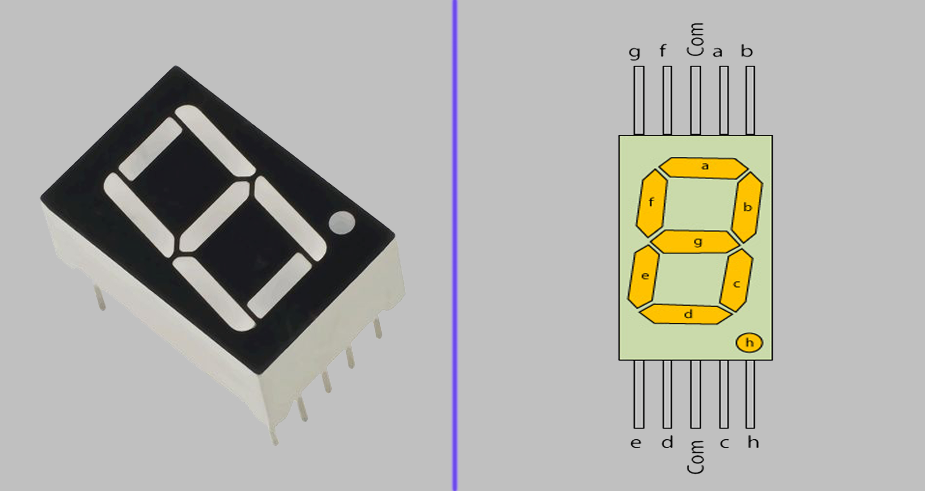
Pin Diagram Of SSD

Slide 6
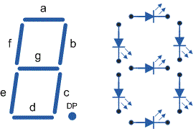
Structure Of SSD

Slide 7
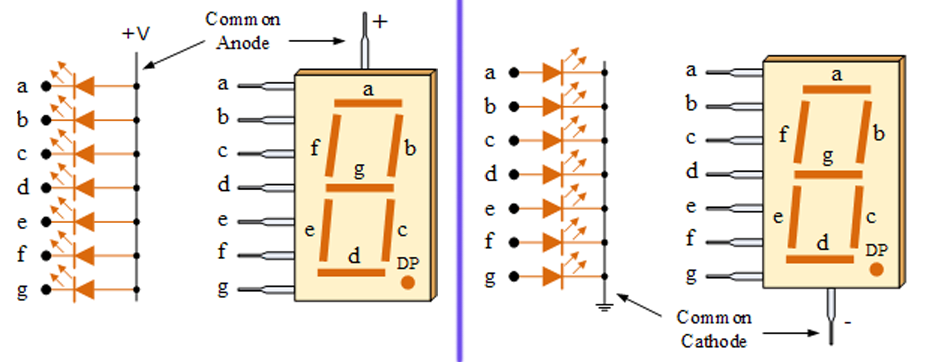
Types Of SSD

Slide 8
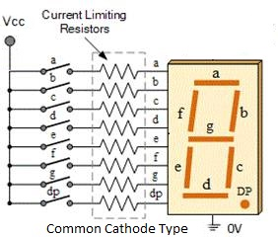
Basic Operation Of SSD

Slide 9
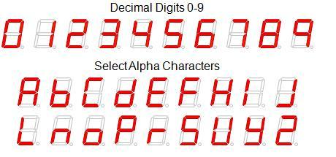
Basic Operation Of SSD

Slide 10
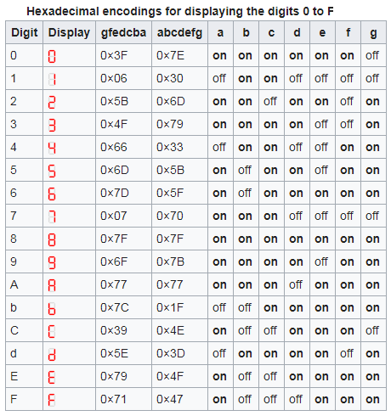
Basic Operation Of SSD

Slide 11
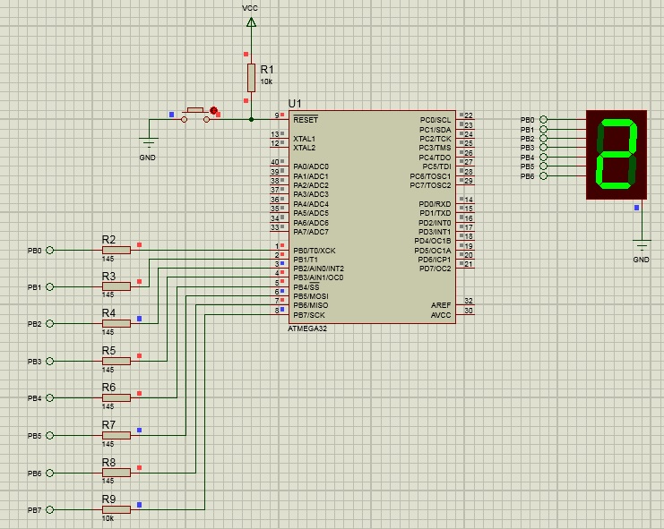
SSD Interfacing with MCU

Slide 12
SSD Interfacing with MCU
#define F_CPU 8000000UL //Use Internal 8MHz Clock Frequency.
#include <avr/io.h> //AVR Input Output Header File
#include <util/delay.h> // AVR Delay Function
int i;
int main(void)
{
DDRB |= ((1<<0) | (1<<1) | (1<<2) | (1<<3) | (1<<4) | (1<<5) | (1<<6) | (1<<7));
int seven_seg[27] = {0b00111111,0b00000110,0b01011011,0b01001111,0b01100110,0b01101101,0b01111101,0b00000111,0b01111111};

Slide 13
SSD Interfacing with MCU
while (1)
{
for(i=0; i<=26; i++)
{
PORTB = seven_seg[i];
_delay_ms(1000);
}
}
}

Slide 14
Interrupt
Interrupts are basically events that require immediate attention by the microcontroller.
When an interrupt event occurs the microcontroller pause its current task and attend to the interrupt by executing an Interrupt Service Routine (ISR) at the end of the ISR the microcontroller returns to the task it had pause and continue its normal operations.

Slide 15
Types Of Interrupt
An internal interrupt is triggered by some source inside the microcontroller, such as timer overflow, ADC data ready, UART data ready, etc.
An external interrupt will use some external source (outside the microcontroller), such as a switch, motion sensor, or similar source, to trigger the interrupt.

Slide 16
AVR Interrupt
The AVR 8-bits microcontroller provide both internal and external interrupt sources.
The internal interrupts are associated with the microcontroller's peripherals. That is the Timer/Counter, Analog Comparator, etc. The external interrupts are triggered via external pins.

Slide 17
Interrupt Interfacing with AVR
Steps taken:
01. Enable Global Interrupt (SREG_bit_I = 1)
02. Set Interrupt Sense (MCUCR)
03. Enable Individual Interrupt (GICR)
04. Writing ISR (Interrupt Service Routine)

Slide 18
Interrupt Interfacing with AVR
void Init_INT0(void)
{
sei(); //SREG |= (1<<I); //This will enable Global Interrupt Function)
MCUCR |= ((~(1<<ISC00)) | (1<<ISC01)); //The falling edge of INT0 generates an interrupt request.
GICR |= (1<<INT0); //Enable Interrupt_0
}

Slide 19
Interrupt Interfacing with AVR
ISR(INT0_vect) //Interrupt Service Routine (ISR)
{
for (int i=7; i>=0; i--)
{
PORTC = (1<<i); //PORTC output shift.
_delay_ms(500); //Delay for 500ms.
}
}

Slide 20
Assignment: ASN1910-1
Write a program that will increase or decrease the Seven-Segment-Value from decimal 0-to-9 by pressing B1 & B2 switches.

Slide 21
Assignment: L621910-2
Name : “Automatic Water Pump Controller”
(Schematic Design & Programming)
Conditions:
Tank empty – Pump ON
Tank full – Pump OFF

Slide 22


Slide 23
Thank You

